Slide 1
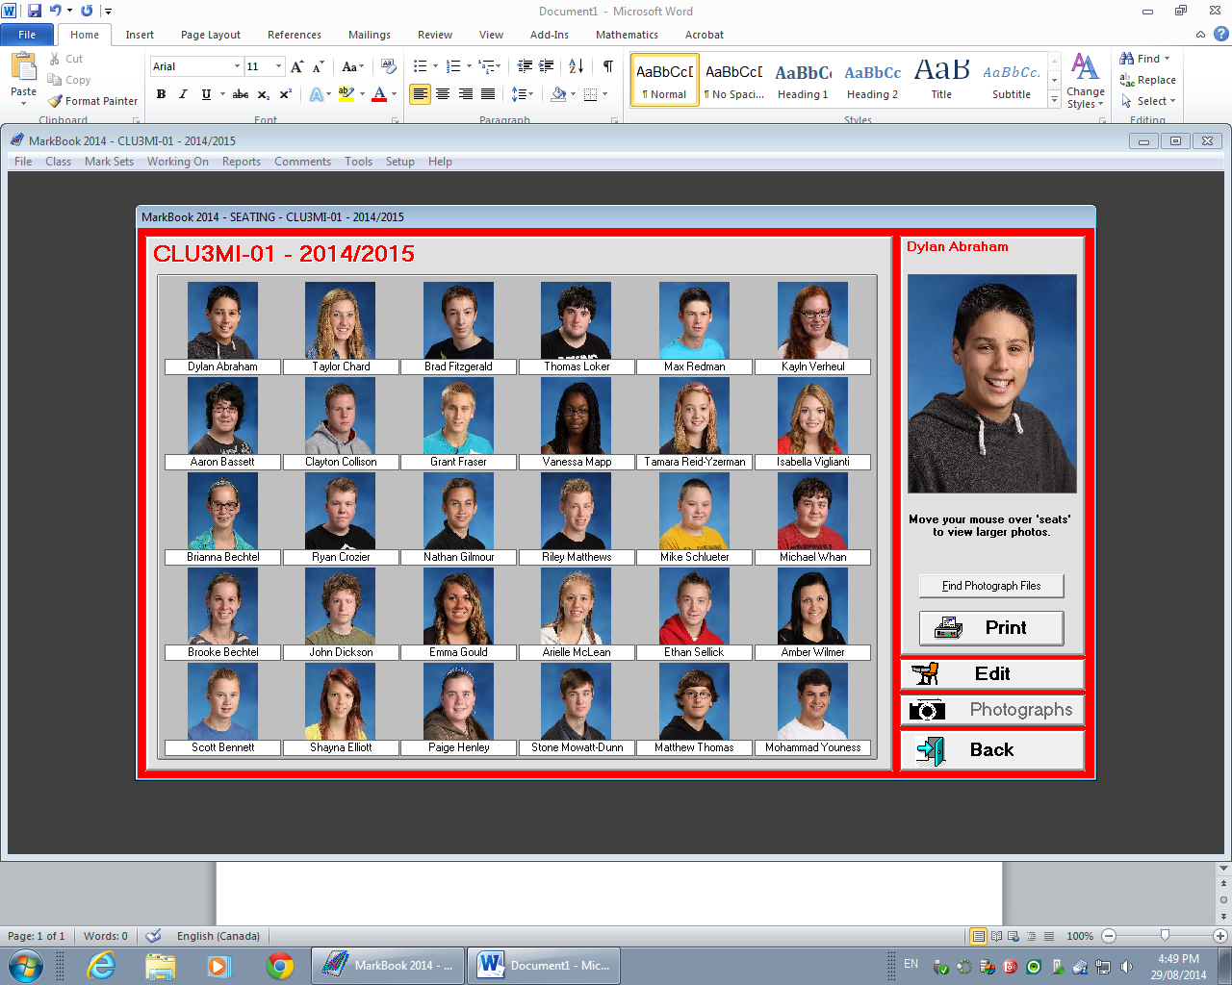
Seating Plan – CLU 3MI-01
Front of Classroom
Windows

Slide 2
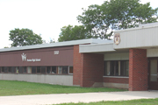

Understanding Canadian Law- CLU 3MI-01
Place: Rm 239
Time: Period A
Teacher: Mrs. Kelly

Slide 3
Understanding Canadian Law
Students should know about the historical development and philosophical foundations of our legal system. Students need to develop respect for the law, an understanding of its relevance to everyday life, and appreciation of the benefits of a dynamic legal system. The study of law enhances students’ ability to participate effectively in society and to think critically and communicate effectively. – The Ontario Curriculum Grades 11 & 12, Revised 2005.
Overall strands include:
Heritage
Rights & Freedoms
Criminal Law & Procedures
Regulation and Dispute Resolution

Slide 4
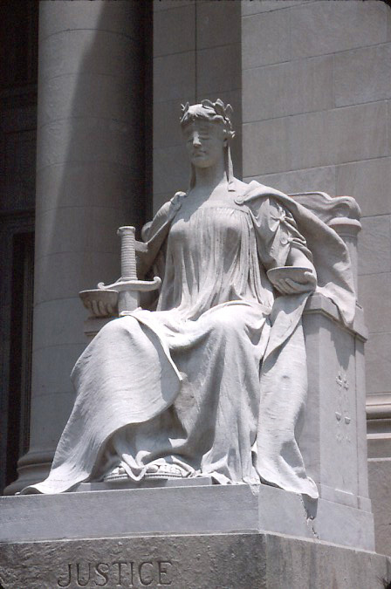
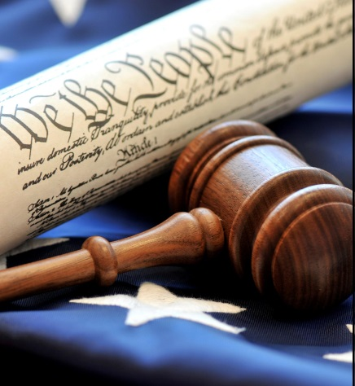
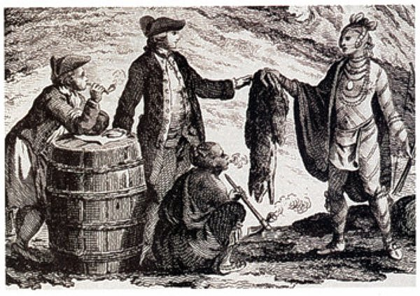
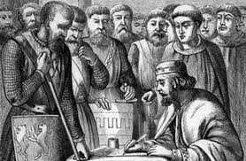
Heritage
Nature & Purpose of Law
Origins of Law
British Influence in Law

Slide 5
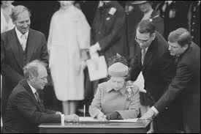



Rights & Freedoms
Charter of Rights & Freedom
Hot Topics: Euthanasia, Abortion

Slide 6
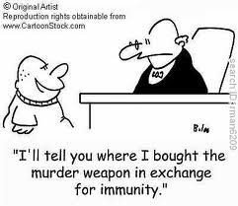


Criminal Law & Procedure
Search, Arrest and seizure
Police Rights & Procedures
Plea Bargaining
Jury Selection

Slide 7


Regulations and Dispute Resolution
Private vs. Public Law
Civil Law
Family Law

Slide 8
Course Supplies
Binder
Textbook
Print copies (Assignments & Summative)

Slide 9
What you will need:
Notebook:
A 3-ring binder with dividers
Textbook (class set):
All About Law, 6rd ed.
Other Learning Materials:
Computer Software, MS PowerPoint, MS Word

Slide 10
Course Website:
www.phscanadianlaw.weebly.com

Slide 11
Essential Learning:
Through skills such as collaboration, critical analysis, communication, and inquiry based thinking, a successful law student will be able to:
Analyze Canada’s legal system by investigating what is law, why society have laws and the categories of law
Examine the impact of historical developments and the law-making process in Canada
Describe the rights and freedoms enshrined in Canada’s democratic legal system and how laws are interpreted, limited, enforced in Canada and in Ontario
Explain how a criminal defence is defined, purposes of sentencing and how it applies to youth in Canada and in Ontario
Describe the procedures and legal institutions involved in bringing a criminal case and civil dispute to trial and resolution
Distinguish between public and private law and analyze the role of law and how it applies to each division of law
Develop an understanding of the role of the Canadian justice system by assessing legal issues and managing conflict through the application of critical thinking and problem solving
Analyze and apply their understanding of the relevance of law within society and their daily lives through the application of legal reasoning

Slide 12
Questions?
Comments?
Concerns?

Slide 13
A Little bit about Mrs. Kelly:
4th year at Preston High school
Courses that I teach: Introduction to Business, Gr. 11 Accounting, Gr. 11 Law, Sports & Entertainment Marketing
Coach: Field Hockey, Girls’ Hockey & Soccer
Clubs: DECA, Yoga Club

